Slide 1

English for Telephoning
Class: 18C1-NNA1
Time: 12.30 – 14.00pm. on Wednesday
Lecturer: Ms. Nguyen Thi Thanh Tu
Faculty of Foreign Languages
Ly Tu Trong College of Ho Chi Minh City

Slide 2
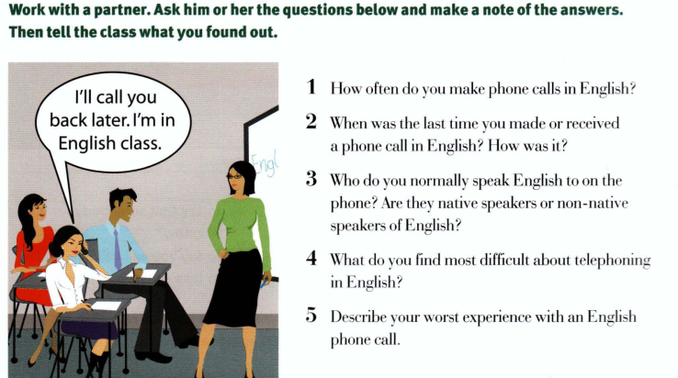
Unit 1: Shall I put you through?

Slide 3
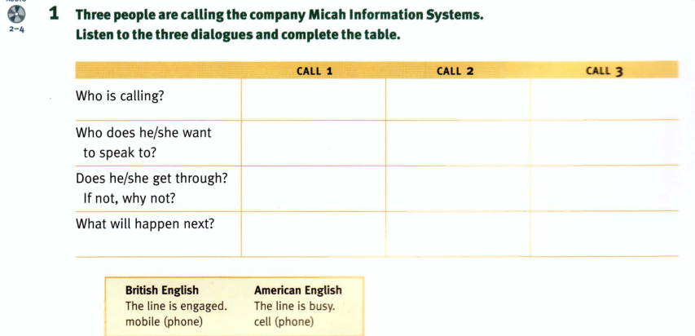

Slide 4
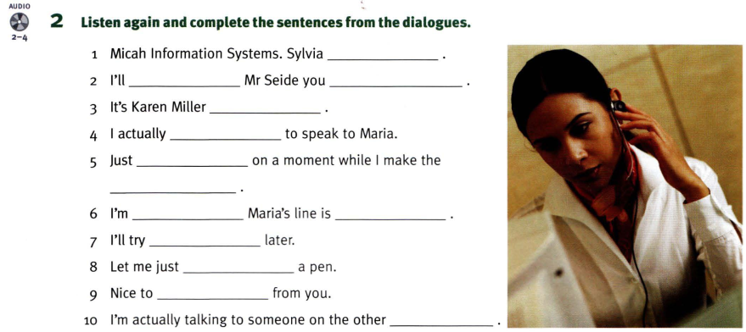
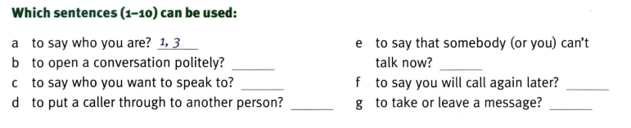

Slide 5
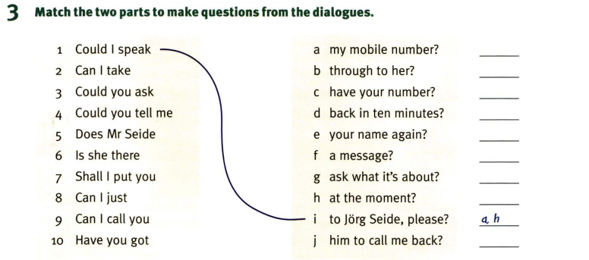
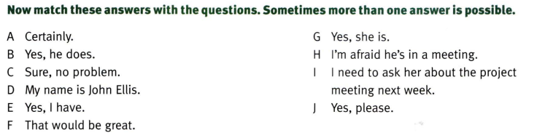

Slide 6
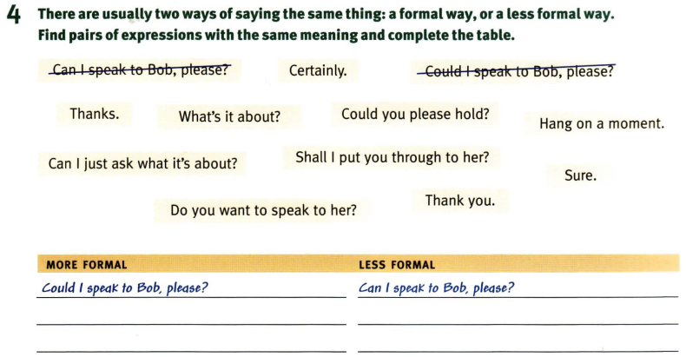

Slide 7
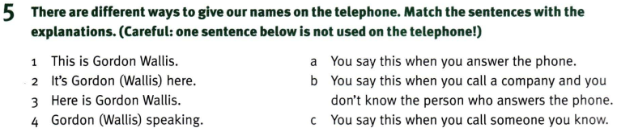
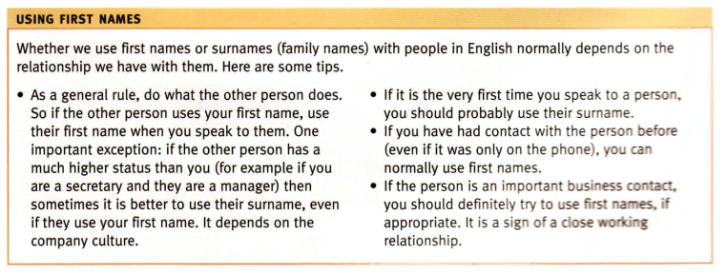

Slide 8
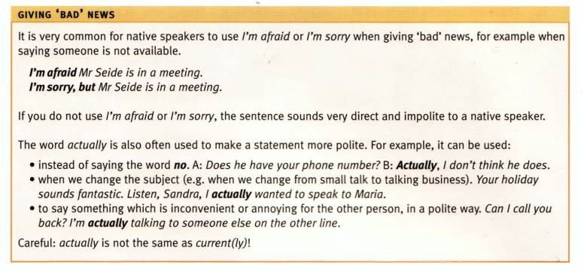

Slide 9
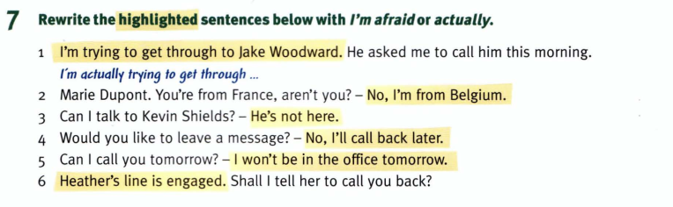
Homework: After these two periods you have to read the tips in part 6 carefully, and do exercises in the part 7 at home.

